Slide 1
Welcome!
Art 1

Slide 2
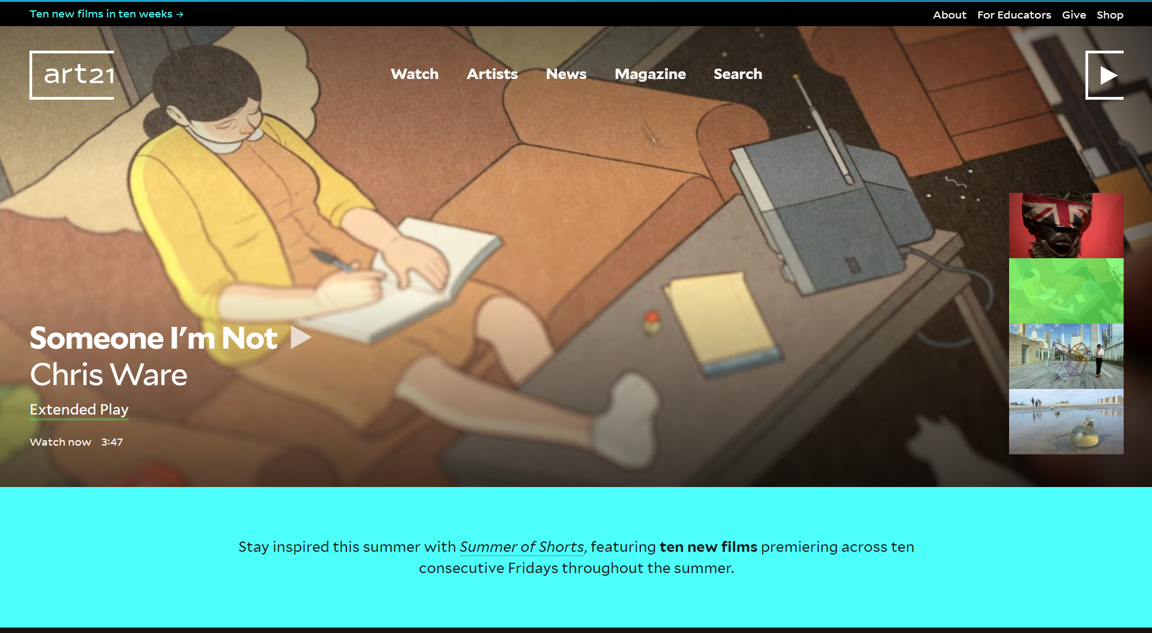
What will this class be like?
Watch Videos about 21st century artists based around a specific theme.
Class discussions about the theme and sometimes worksheets
Present a lesson to you around the theme.
We will experiment with a variety of mediums.
THEMES
Identity
Place
Consumption

Slide 3
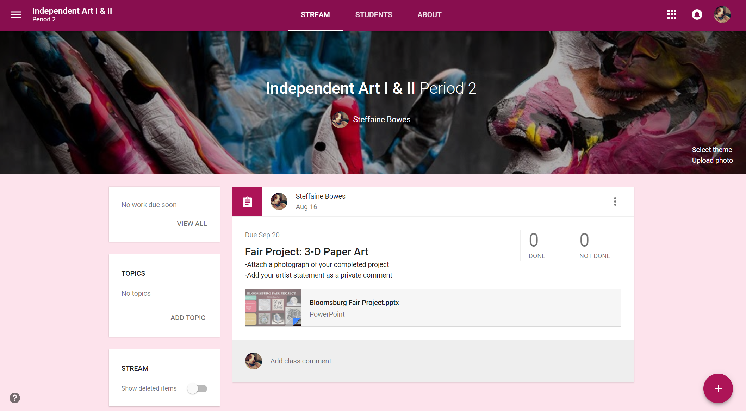
Google Classroom
For Each Project:
Complete the project
Write artist statement
Photograph your artwork
Submit on Google Classroom:
Photograph
Artist statement
Pd 3: 2bsrz3
Pd 10: v261m9

Slide 4
Grades
Each Project:
Classroom Management | 50
Artwork | 20
Artist Statement | 20
Photograph Submission | 10
Participation/ Use of Time | Classroom Respect
Using time effectively from beginning to end of class, EVERY DAY. Being engaged with high attention and high commitment to independent projects | Using tools safely and appropriately CLEANING up after yourself Having respect for your artwork and classmates artwork
100

Slide 5
Class Rules
Participate
Respect yourself
Respect Others
Respect Property
The ONLY time you are allowed to use cell phones:
PINTEREST
MUSIC (HEADPHONES ONLY)

Slide 6
EMERGENCY!!!!
FIRE ALARM
- Quickly and Quietly get up
- Exit through door
-Turn Left
-Go out doors by Guidance Office
-Meet at the street to the left of the (sidewalk Y).
LAST ONE TURN LIGHTS OFF AND CLOSE DOOR
Lock Down-Take Cover
- Quickly and Quietly get up
Make sure door is shut and lights are off
Make sure blinds are closed
Turn Radio off
Hide in Closet with door shut and lights off.

Slide 7
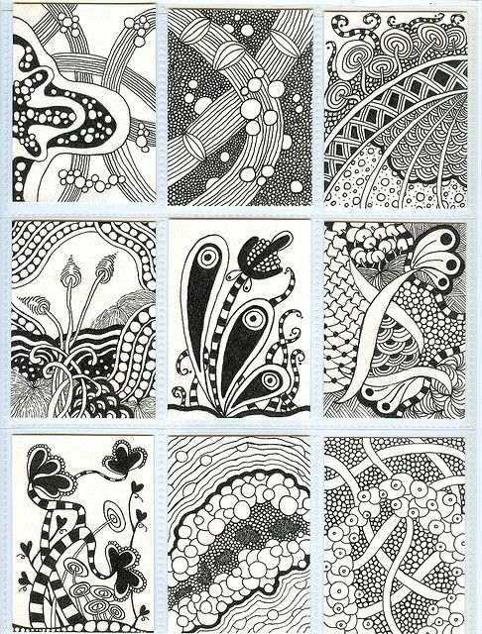
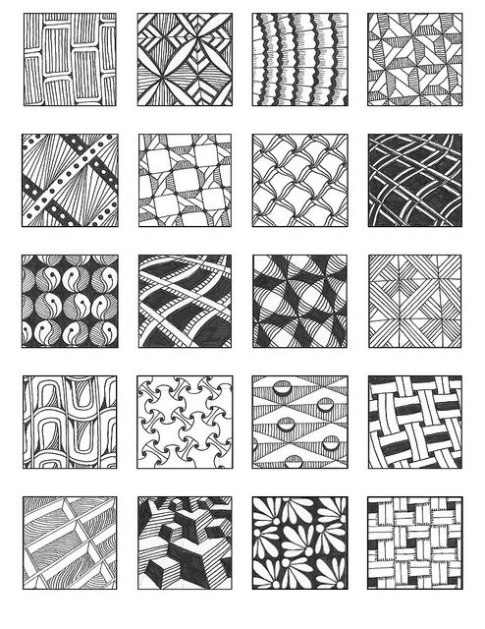
Artist Trading Cards
Zentangle

