Slide 1
Welcome!
This media based course first introduces the student to multiple jewelry making mediums. The student will work with simple mediums such as polymer clay and resin to begin the course but will quickly move on to more advanced mediums such as glass bead making and metal working. The student will experiment and practice the skills of each medium prior to creating their theme based projects.
After experimenting and practicing with all of the jewelry techniques/mediums the course will move on to independent projects where the student will plan, organize and prepare their own project based around a course theme. The student will be able to choose their own techniques and medium for their projects but is required to think like an artist and use creative problem solving skills to make it all come to life.
Jewelry

Slide 2
What will this class be like?
Boot Camps
Polymer Clay
Metals
Enameling
Glass Beads
Resin Casting
THEMES
Identity
Artist of Inspiration
Shape
Nature
Etc…

Slide 3
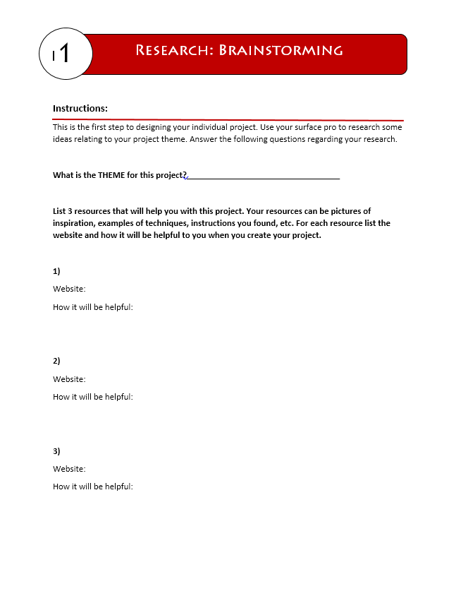
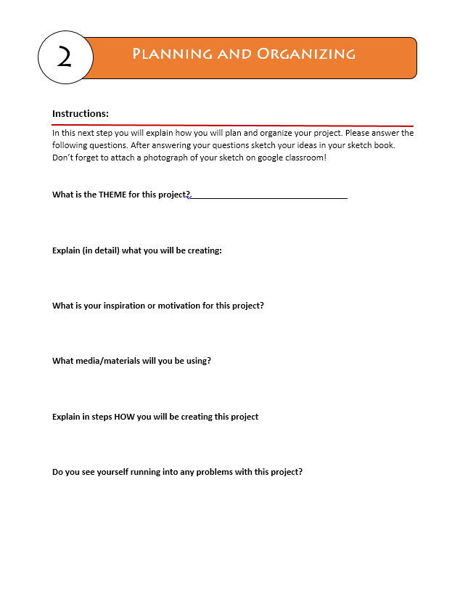
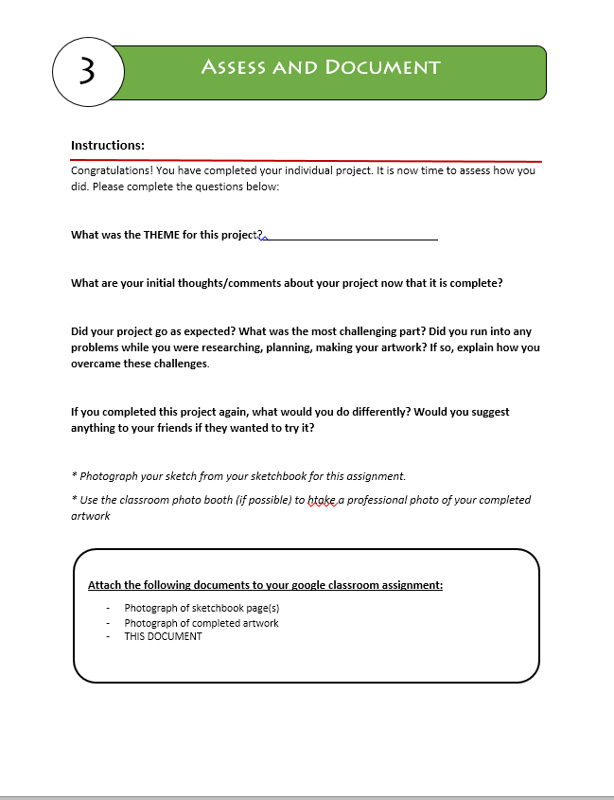
What will this class be like?

Slide 4
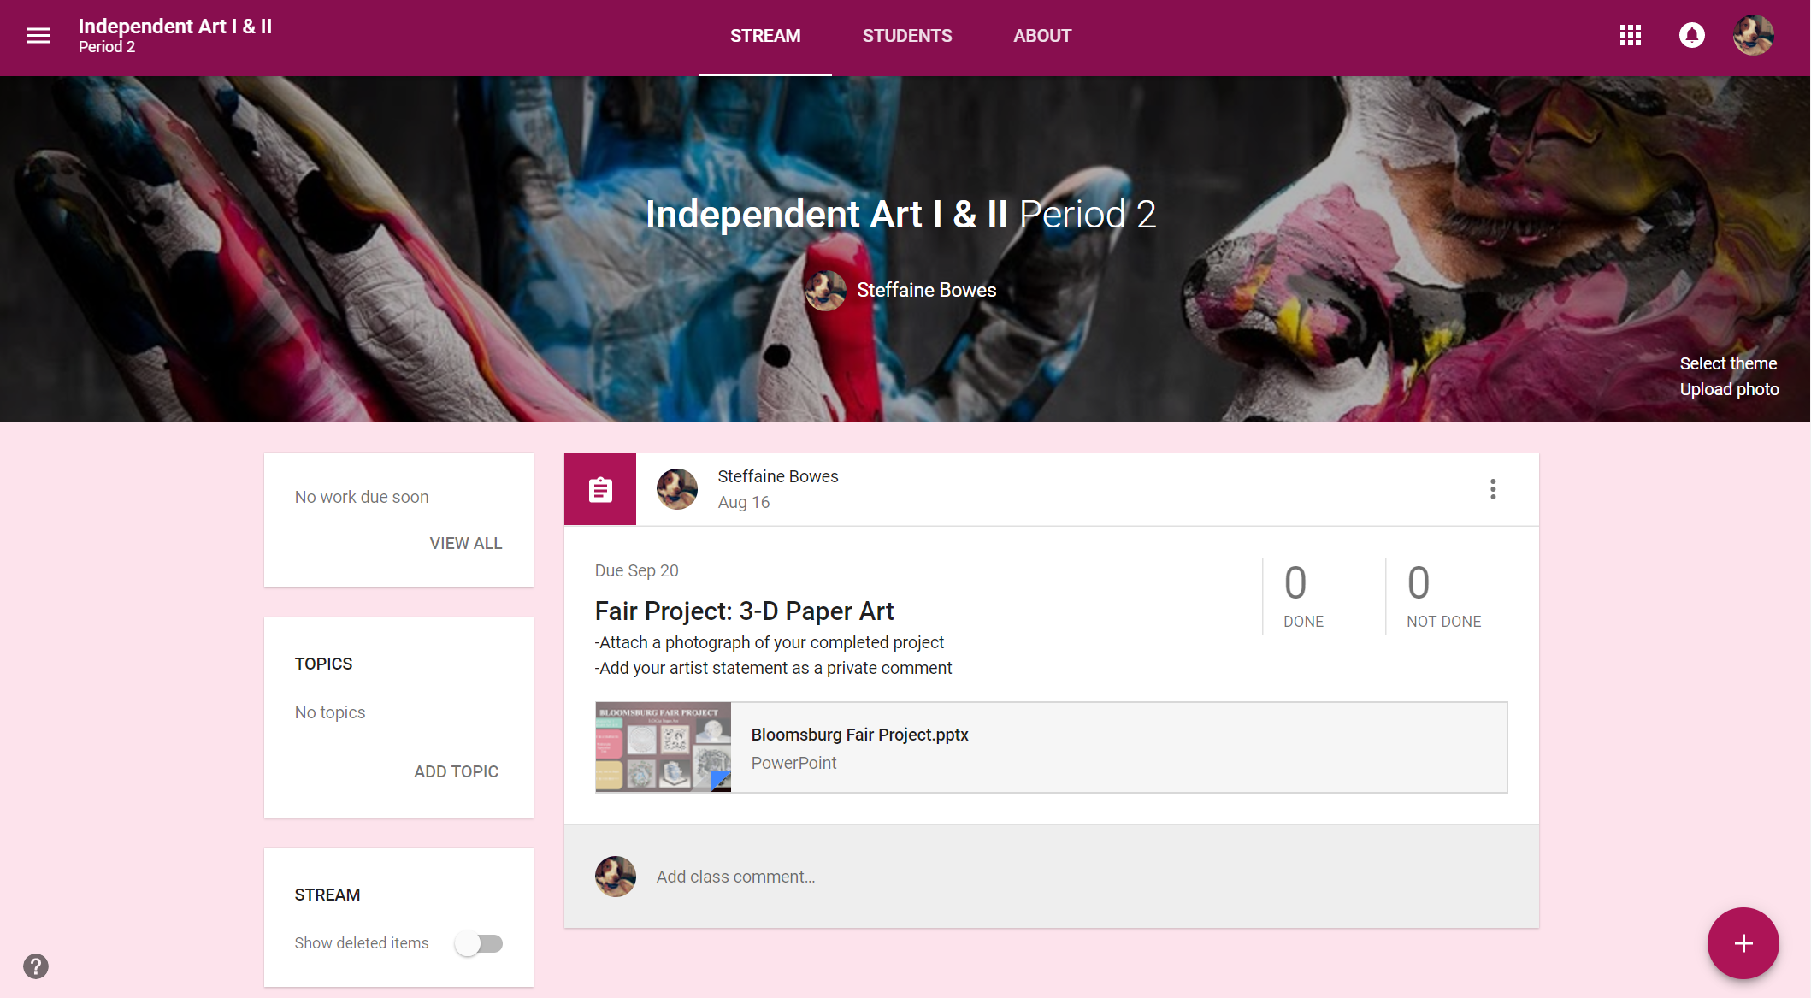
Google Classroom
For Each Project:
Complete “independent project form”
Create your artwork
Write artist statement
Photograph your artwork
Submit on Google Classroom:
Independent project form
Photograph
Artist statement
188sid

Slide 5
Grades
Each Project:
Classroom Management | 50
Independent Project Form | 20
Artist Statement | 20
Photograph Submission | 10
Participation/ Use of Time | Classroom Respect
Using time effectively from beginning to end of class, EVERY DAY. Being engaged with high attention and high commitment to independent projects | Using tools safely and appropriately CLEANING up after yourself Having respect for your artwork and classmates artwork
100

Slide 6
Class Rules
Participate
Respect yourself
Respect Others
Respect Property
The ONLY time you are allowed to use cell phones:
PINTEREST
MUSIC (HEADPHONES ONLY)

Slide 7
EMERGENCY!!!!
FIRE ALARM
- Quickly and Quietly get up
- Exit through door
-Turn Left
-Go out doors by Guidance Office
-Meet at the street to the left of the (sidewalk Y).
LAST ONE TURN LIGHTS OFF AND CLOSE DOOR
Lock Down-Take Cover
- Quickly and Quietly get up
Make sure door is shut and lights are off
Make sure blinds are closed
Turn Radio off
Hide in Closet with door shut and lights off.

Slide 8
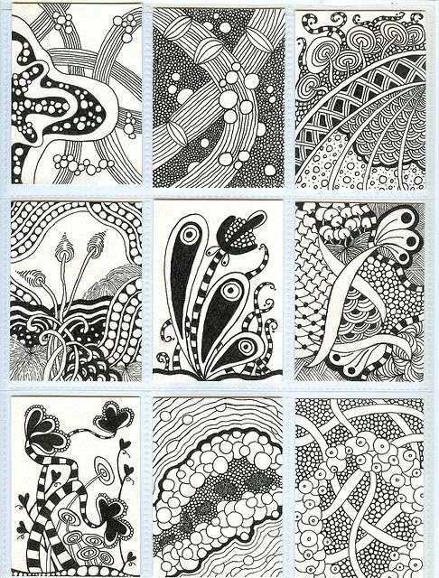
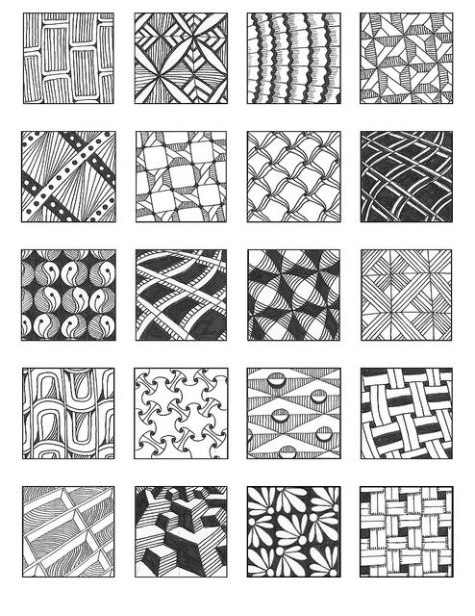
Artist Trading Cards
Zentangle

